Slide 1
Twizzler : a Data-Centric OS for Non-Volatile Memory
Bittman Daniel, Alvaro Peter, Pankaj Mehra, Darrell D. E. Long, & Ethan L. Miller
In 2020 USENIX Annual Technical Conference
2020. 08. 10
Presentation by Han, Yejin
32164881@dankook.ac.kr
Notes:
Let me begin my presentation.
Today I will give a presentation on “Fully Automatic Stream Management for Multi-Streamed SSDs Using Program Contexts”

Slide 2
Introduction
Motivation
Twizzler
Evaluation
Conclusion
Notes:
This is the outline on my talk.
First, I will describe garbage Collection overhead in SSDs and Multi-Streamed SSD
Then, the details of PCStream design and analysis results are presented.
Finally, I will conclude my talk.

Slide 3
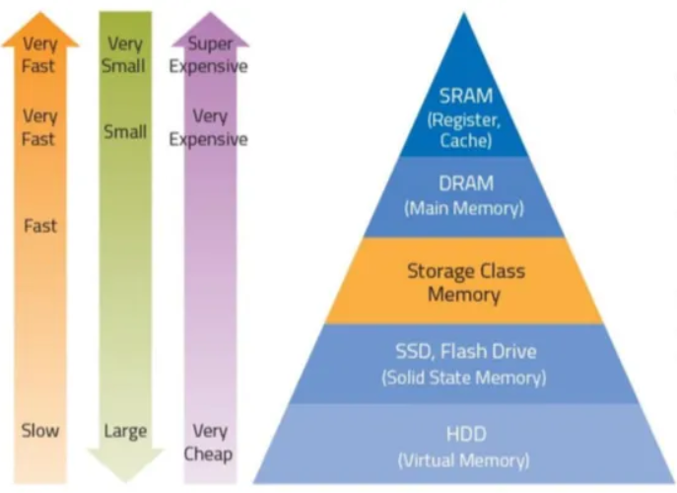
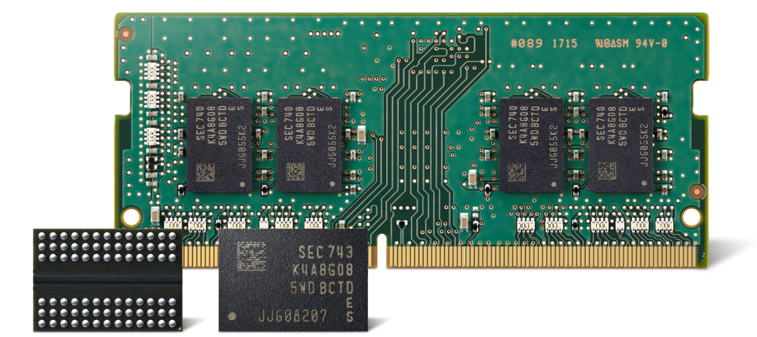

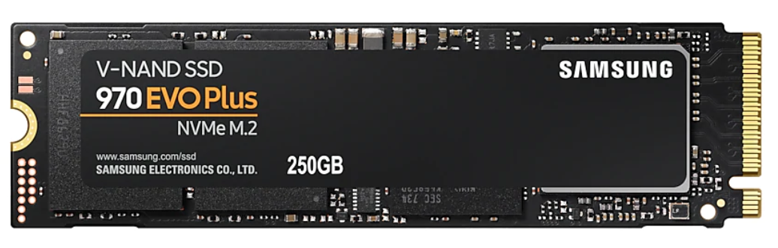
1. Introduction
Hardware Trends
Non-Volatile Memory
Performance, Capacity, Cost
DRAM
NVM
SSD
Notes:
NVM은 DRAM보다 용량이 크고 ssd보다 속도가 빠르다.

Slide 4
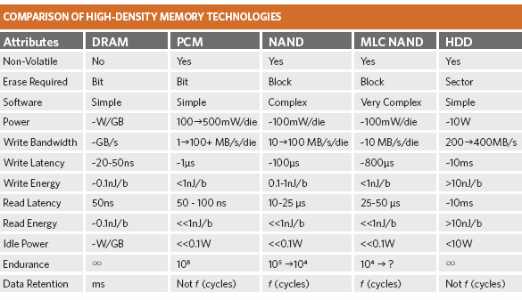
1. Introduction
NVM characteristics
Non-volatile
R/W Performance
Byte-addressable
NVM->Storage
1.5-8x
Byte-addressable Yes Yes No
출처: https://research.cs.wisc.edu/sonar/wiki/pmwiki.php?n=Mnemosyne.PCMTechnology
Notes:
DRAM과 PCM, NAND간의 속도차이가 몇배가 나는지 설명
영구적인 데이터를 접근할 때 메모리에 접근할 때처럼 byte단위로 접근이 가능하다 그래서 메모리와 스토리지 간의 페이지 블록 단위의 접근을 없앨 수 있다.

Slide 5
2. Motivation
CPU
store
load
Two-tier memory hierarchy
Kernel
Main Memory
Serialization
write
read
Deserialization
Storage
Notes:
커널 개입을 여기서 써야하는가..?
동기: NVM을 잘 써야한다.

Slide 6


2. Motivation
CPU
store
load
CPU
Two-tier memory hierarchy
load
store
Kernel
load
store
Main Memory
Kernel
Single level Interface
Serialization
write
read
Main Memory
NVM
Deserialization
Storage
Byte-addressable
Block-addressable
Why?
Persistent data should be operated on directly and like memory
Notes:
커널 개입을 여기서 써야하는가..?
동기: NVM을 잘 써야한다.

Slide 7
3. Twizzler
Requirements
OS must evolve to support future trends in memory hierarchy organization.
Twizzler is an OS designed around NVM for direct access to memory.
Low overhead by removing the kernel from persistent data access path

Slide 8
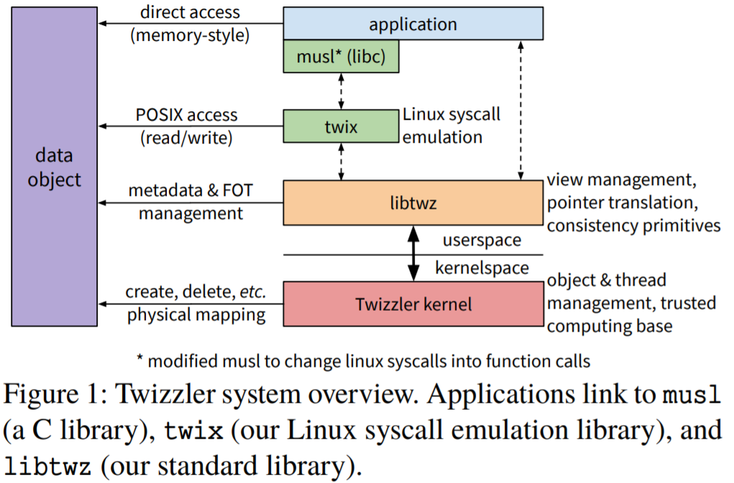
3. Twizzler
Library OS
Design
Object Management
Address space Management
Persistent Pointers
Open-Source
Notes:
So, I will describe garbage Collection overhead in SSDs
As you all know, GC copies valid pages and reclaims free space. This results in write amplification, which has a significant impact on life and performance.
To reduce this overhead, a lot of research has been done in the past and there are examples A and B.

Slide 9
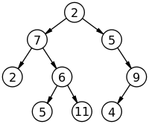
3. Twizzler
Object Management
Twizzler organizes data into objects
Twizzler uses objects as the unit of access control
Read/Write/Execute Permissions (MMU)
An object is flexible in its contents (ex. A single node, the entire tree)
Objects are created/deleted by the create/delete system call
Application
Twizzler
NVM
Object
create
Object
Object ID
(128 bit)
return

Slide 10
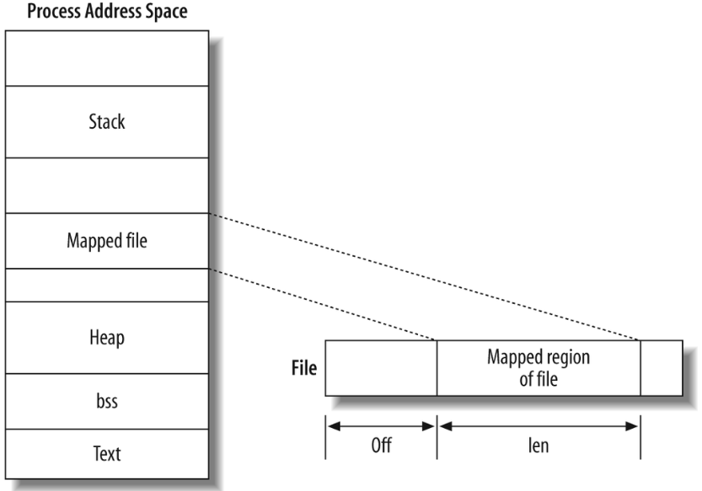
3. Twizzler
Address Space Management
Twizzler maps persistent objects into the VA space via libtwz
Kernel and user-space share a view that defines an AS layout
Process N
Object
Object
Object
Object A
libtwz(library)
Object B
View N
mmap(sys_call)
User
User
view
View(Object)
Addr 100 | Object ID
Addr 108 | Object ID
Kernel
Kernel
File system
?
No File system
SSD
NVM
Object
Notes:
Memory mapped I/O mmap I/O

Slide 11
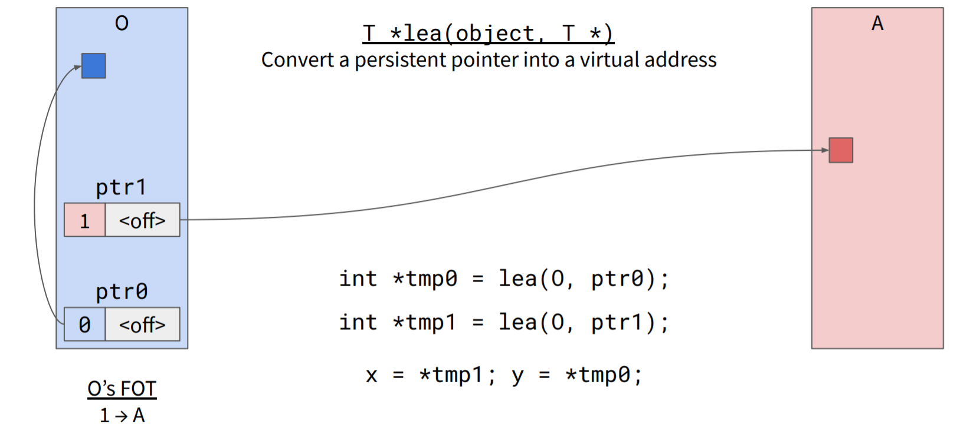
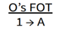
3. Twizzler
Persistent Pointers
Twizzler provides cross-object persistent pointers
A cross-object pointer is stored as a 64 bit FOT_idx:offset value
Twizzler use indirection through a per-object foreign object table (FOT)
The FOT is an array of entries that each stores an object ID and flags
intra-object
pointer
Notes:
So, I will describe garbage Collection overhead in SSDs
As you all know, GC copies valid pages and reclaims free space. This results in write amplification, which has a significant impact on life and performance.
To reduce this overhead, a lot of research has been done in the past and there are examples A and B.

Slide 12
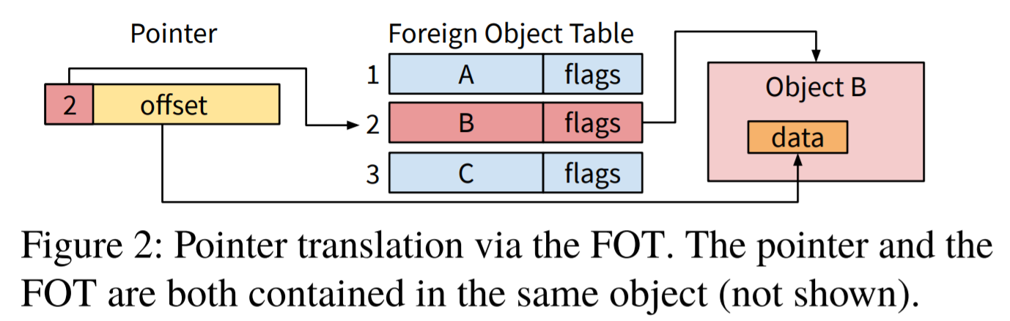
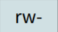


3. Twizzler
Persistent Pointers
Twizzler provides cross-object persistent pointers
A cross-object pointer is stored as a 64 bit FOT_idx:offset value
Twizzler use indirection through a per-object foreign object table (FOT)
The FOT is an array of entries that each stores an object ID and flags
Object O
64 bit
64 bit
128bit Direct pointer→ 64bit pointer → Cache Hit
Notes:
So, I will describe garbage Collection overhead in SSDs
As you all know, GC copies valid pages and reclaims free space. This results in write amplification, which has a significant impact on life and performance.
To reduce this overhead, a lot of research has been done in the past and there are examples A and B.

Slide 13

Notes:
So, I will describe garbage Collection overhead in SSDs
As you all know, GC copies valid pages and reclaims free space. This results in write amplification, which has a significant impact on life and performance.
To reduce this overhead, a lot of research has been done in the past and there are examples A and B.

Slide 14
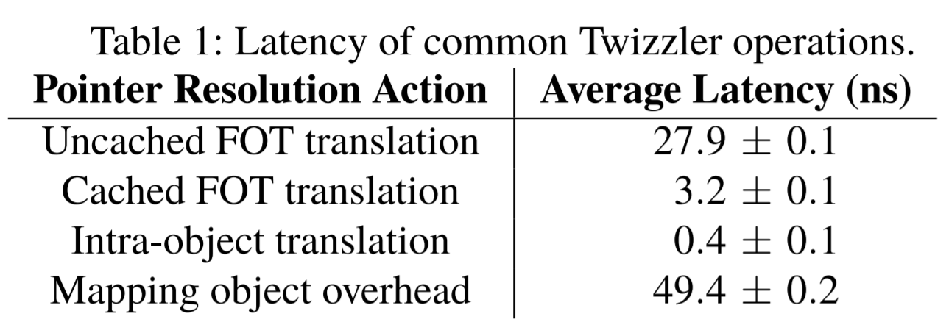
4. Evaluation
Micro benchmarks
Notes:
So, I will describe garbage Collection overhead in SSDs
As you all know, GC copies valid pages and reclaims free space. This results in write amplification, which has a significant impact on life and performance.
To reduce this overhead, a lot of research has been done in the past and there are examples A and B.

Slide 15
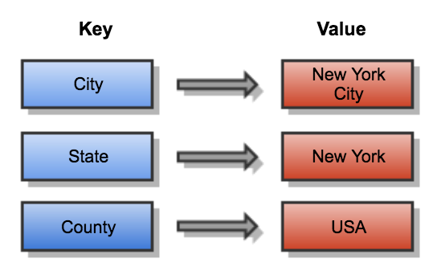
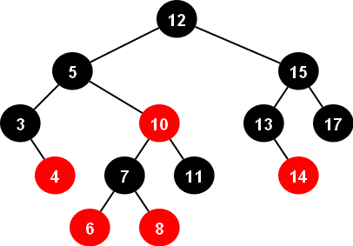
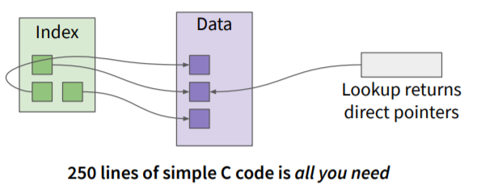
4. Evaluation
Case Study
1) Key-Value Store 2) Red-Black Tree
ramrbt
DRAM
NVM
unixrbt vs. twzrbt
Simpler
Data sharing

Slide 16


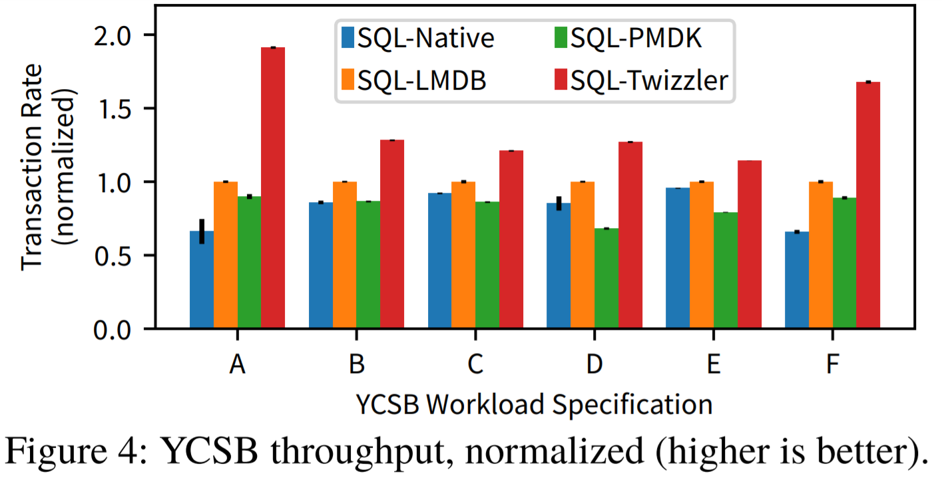
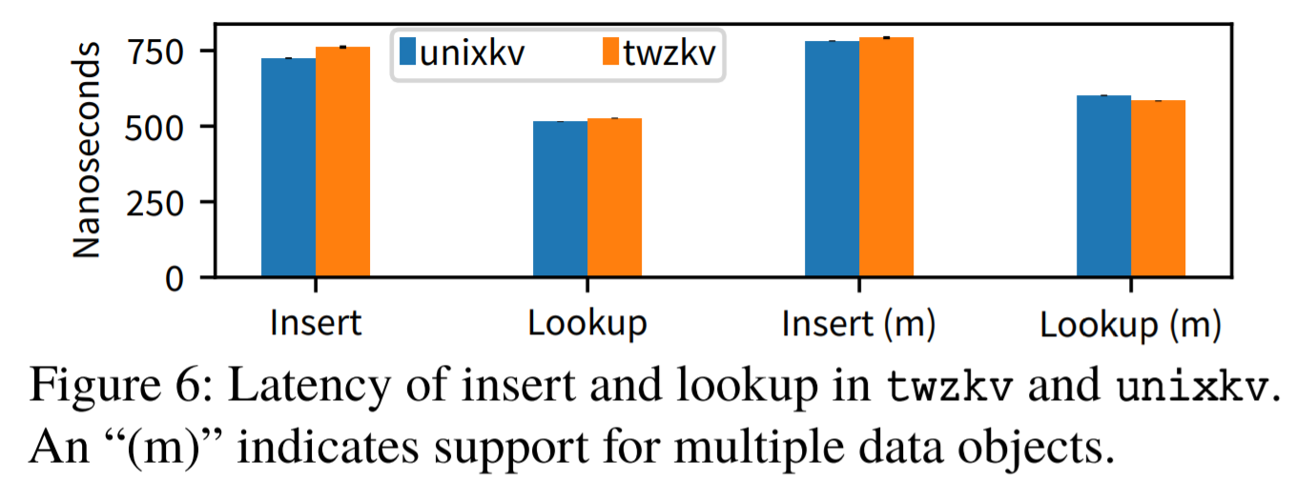
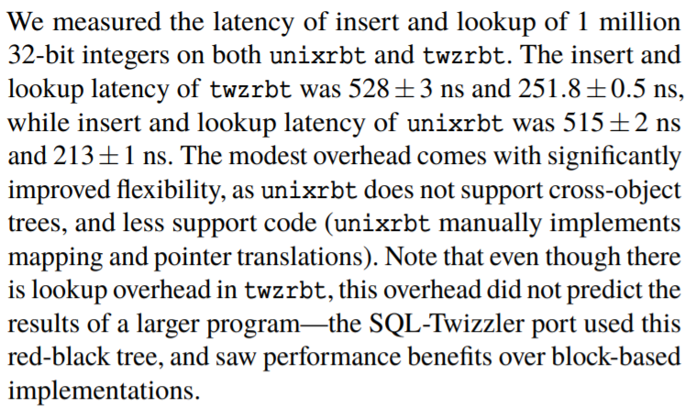
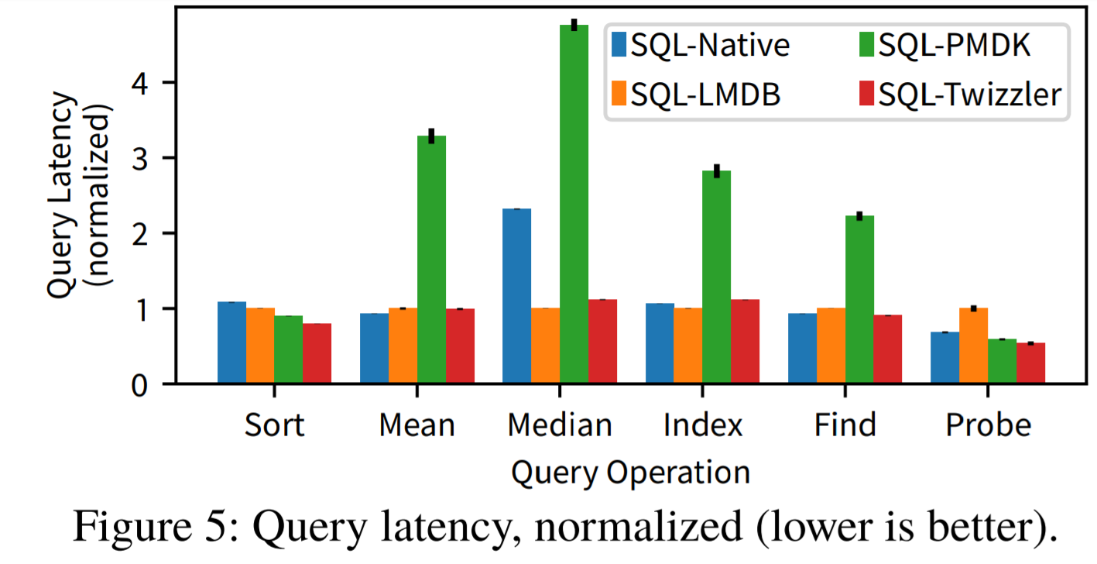
4. Evaluation
Performance
1) Key-Value Store 2) Red-Black Tree 3)SQLite
Notes:
So, I will describe garbage Collection overhead in SSDs
As you all know, GC copies valid pages and reclaims free space. This results in write amplification, which has a significant impact on life and performance.
To reduce this overhead, a lot of research has been done in the past and there are examples A and B.

Slide 17
5. Conclusion
Future trends in memory hierarchy
- Byte-addressable, non-volatile memory NVM
Low latency and the direct-access nature of NVM
- Remove the kernel from I/O path, need not to serialize
- Object/Address space management, persistent pointers
Evaluation
- Simple implementation, high performance
Notes:
So, I will describe garbage Collection overhead in SSDs
As you all know, GC copies valid pages and reclaims free space. This results in write amplification, which has a significant impact on life and performance.
To reduce this overhead, a lot of research has been done in the past and there are examples A and B.

Slide 18
Q&A
2020. 08. 10
Presentation by Han, Yejin
32164881@dankook.ac.kr
Notes:
Let me begin my presentation.
Today I will give a presentation on “Fully Automatic Stream Management for Multi-Streamed SSDs Using Program Contexts”

